Slide 1

Beyond Robots:
How Resellers Can Tap Into the
Growing Automation Boom!
Speakers:
Kevin Ledversis, VP of Sales, Newcastle
Ed Lynes, Managing Partner, Woden

Slide 2
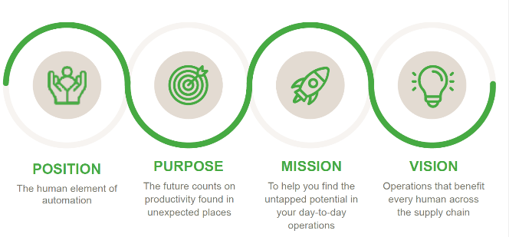
OUR story is YOUR story
WHY?

Slide 3
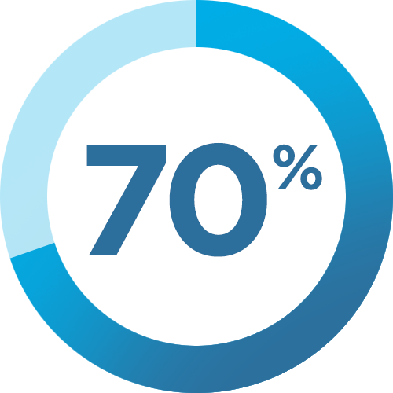
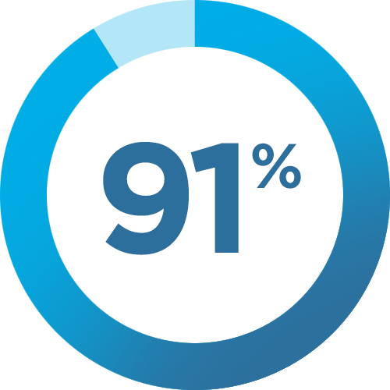
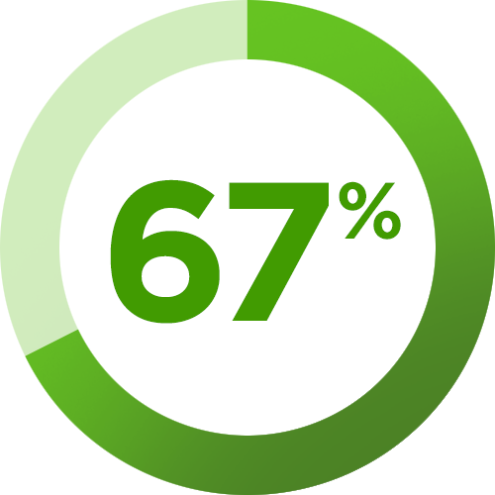
Budget for automation is growing...
Warehouse decision-makers are investing in technology:
have budget set aside for automation
solutions within the next year (Zebra/Vecna Robotics)
have plans to invest in technology by 2028 (Zebra)
say they don’t know where to start! (Zebra)

Slide 4
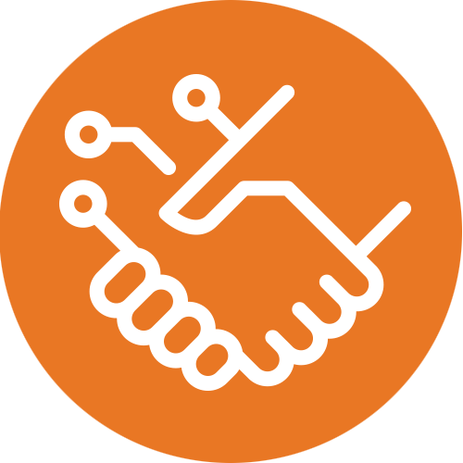
...but workers are still critical:
Robots can’t compete with workers in many tasks
Robots “fail at targeted picking”
and are “too slow for stacking” (amazon/dhl)
“Robots struggle to master skills humans
can do without much trouble” (ny times)
Robots and humans perform well side by side
Amazon invested in robots while doubling employee count in fulfillment centers (ny times)
Robots work well alongside human pickers, transporting goods to the packaging station (dhl)

Slide 5
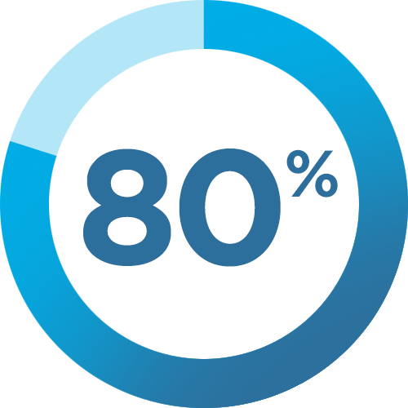
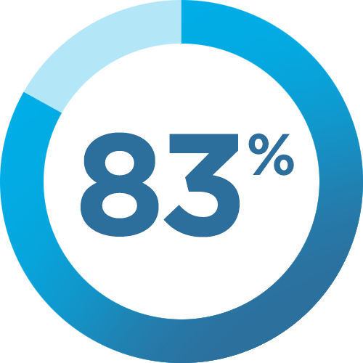
The future is hybrid
Maximizing worker productivity and retention is key
of decision-makers agree that more technology
helps workers meet productivity goals (Zebra)
of workers feel more valued when employers
provide technology to help them do their work (Zebra)

Slide 6
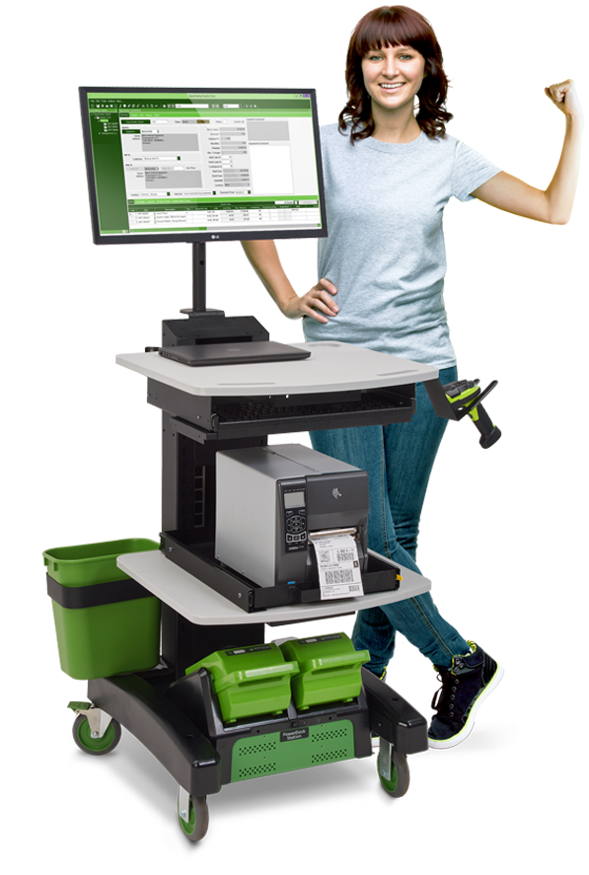
The Human Element of Automation
Taps into growing automation budgets
An easy automation entry-point and a bridge to the future
Adds value at every stage of automation
Low cost/high impact
Immediate ROI

Slide 7
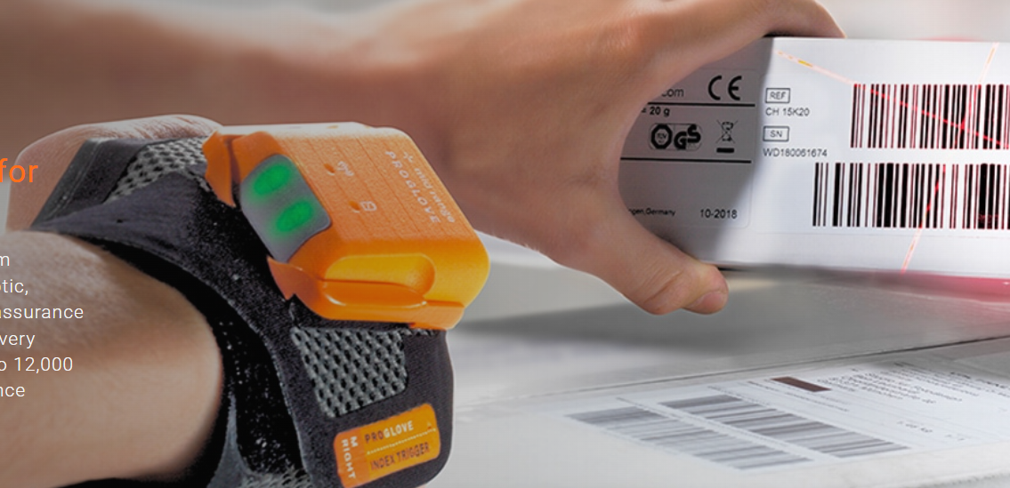

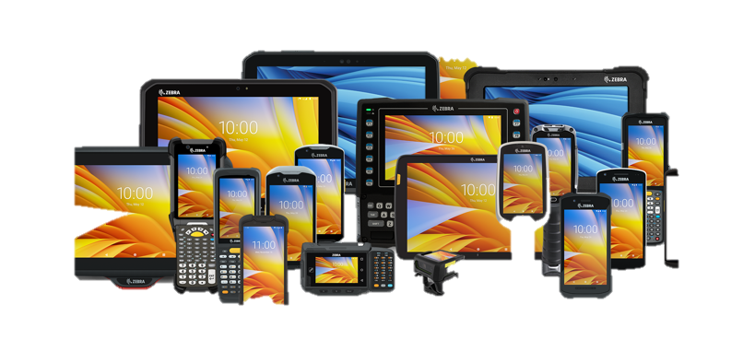
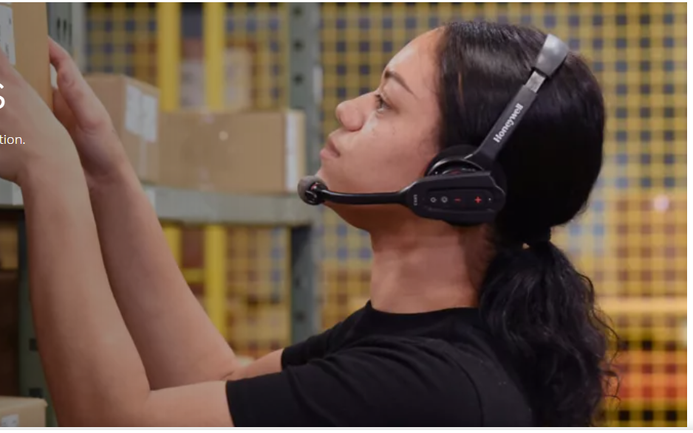
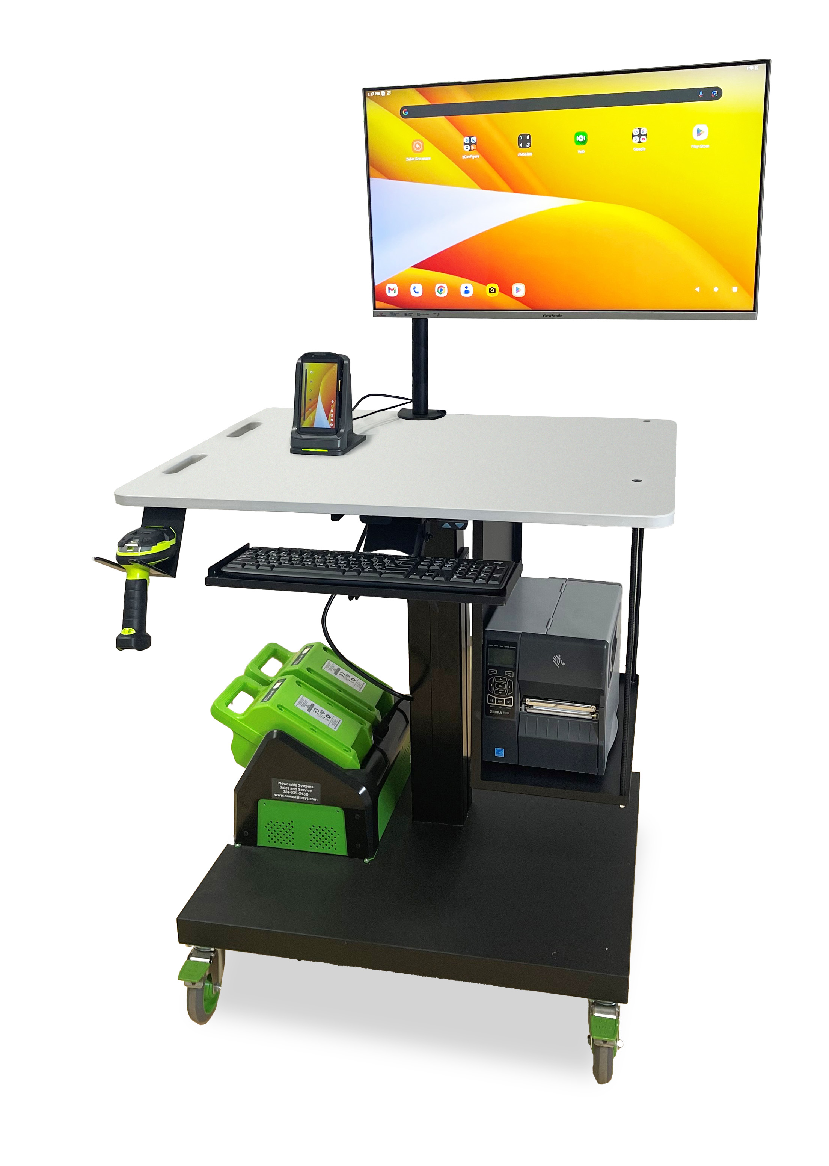
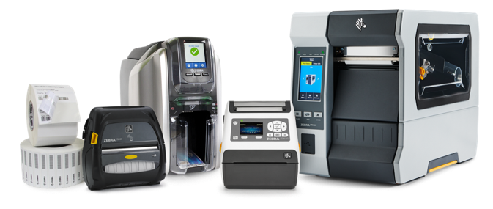
Arm the Warehouse Athlete

Slide 8
Show me the IMPACT

Slide 9
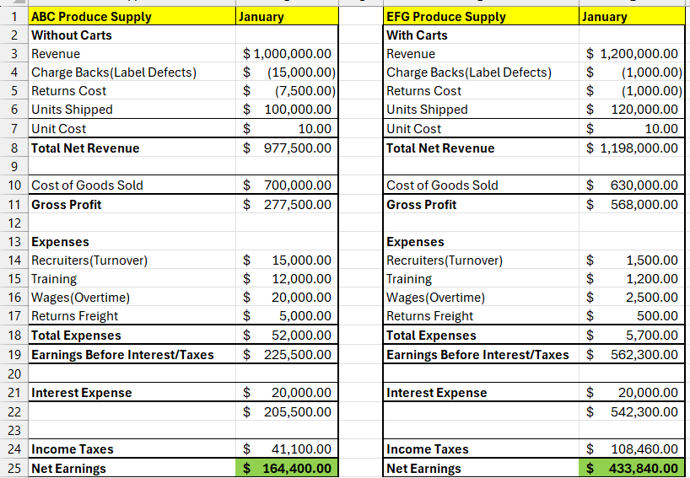
Impact direct labor
Without Carts
With Carts

Slide 10
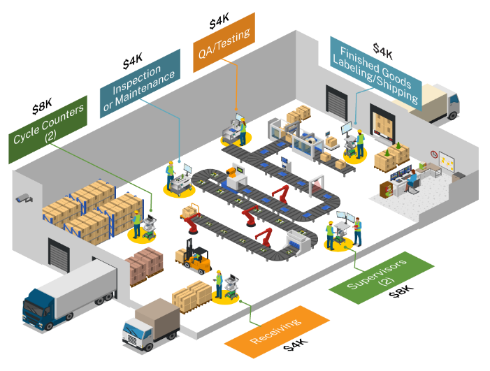

Making money where?
MANUFACTURING
Potential Profit per Site $6,800
Equipment Profit
8 Carts: $32K
4 Printers: $ 4K
6 Scanners: $ 4K
2 Tablets: $ 2K
$4,800 +/-
$800 +/-
$800 +/-
$400 +/-

Slide 11
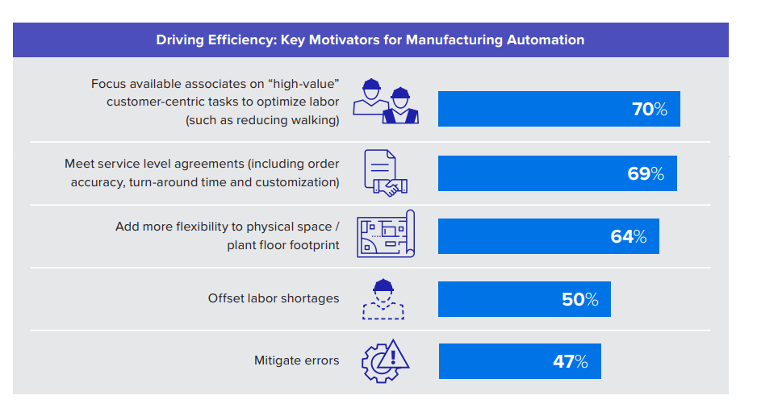
Motivation To Buy
Zebra

Slide 12
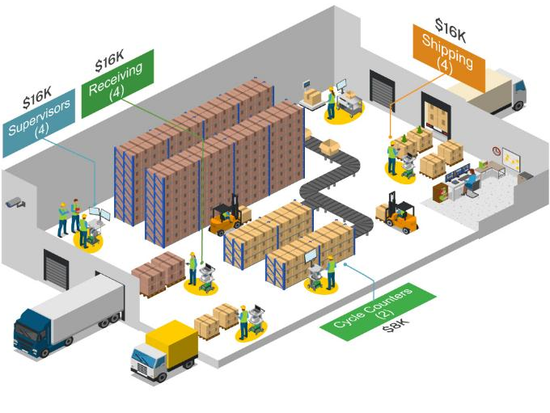
Making money where?
WAREHOUSE/DC
Potential Profit per Site $14,700
Equipment Profit
14 Carts: $56K
10 Printers: $10K
4 Tablets: $ 4K
$8,400 +/-
$1,500 +/-
$4,800 +/-

Slide 13
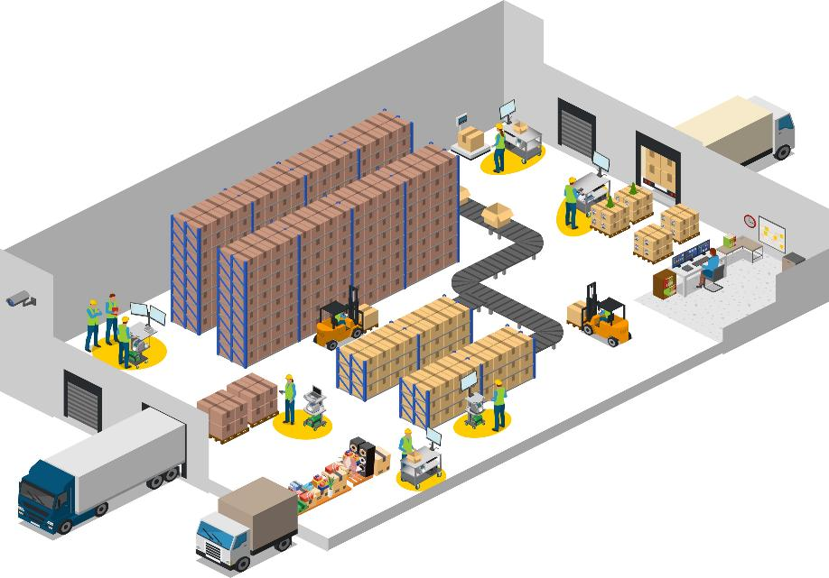

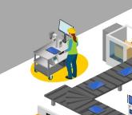



Benefits to the customer
RECEIVING
Productivity Increased: UPH 15-50%
Metrics: Dock to Stock Time
Accuracy: Eliminate mis-labeled products
SHIPPING
Productivity Increased: UPH 15-50%
Metrics: Order Cycle Times
Accuracy: Eliminate mis-labeled shipments
SUPERVISORS
Productivity Increased: 30% from Engagement
QA/QC
Information Accuracy
CYCLE COUNTERS
Accuracy: Maintain world-class inventory accuracy 99%
OVERARCHING VALUE
Happier employees means greater retention!
ROI for everything in 6-8 months including devices!

Slide 14
3 Takeaways:
It’s important to guide your customers through this transition to automation
Your customers want “things” that deliver tangible outputs TODAY
Focus on the lowest hanging fruit – optimizing their people

Slide 15

Contact Anytime
Kevin Ledversis, VP of Sales, Newcastle
P: 978-882-1017
E: kledversis@newcastlesys.com
LinkedIn: https://www.linkedin.com/in/kevinledversis/
Ed Lynes, Managing Partner, Woden
P: 844-GO-WODEN x505
E: elynes@wodenworks.com
LinkedIn: https://www.linkedin.com/in/edwardtlynes/

